Slide 1
面向对象程序设计（Java 语言）
北京理工大学 耿晶
Email :janegeng@bit.edu.cn
Notes:
这门课主要的内容是学习面向对象的编程思想和方法，java 是实践该方法论的工具。

Slide 2
课程大纲：24理论+8节实验
见乐学网站
成绩评定：
60%考试+10%考勤+30%实验

Slide 3
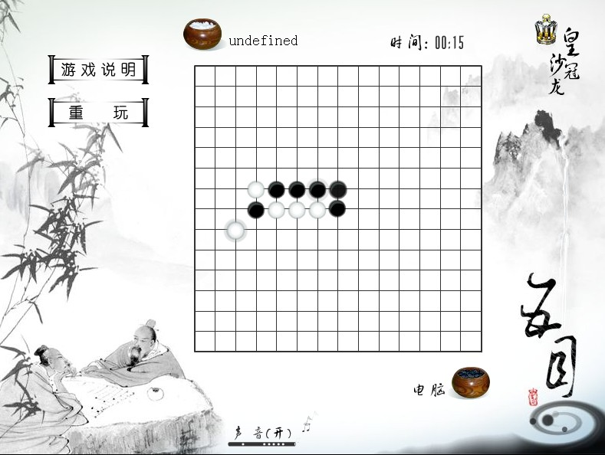
前言：面向对象vs面向过程
面向过程：首先分析问题的步骤，按步骤实现
程序=算法+数据结构
面向对象：将客观事物看作具有状态和行为的对象，通过抽象找出同一类对象的共同状态和行为，构成类。可以提高程序的复用性和可扩展性。
Notes:
面向对象的编程
面向过程的编程

Slide 4
1、java的跨平台性
C++ Build process
Java Build process
Write once ,Run everywhere
一次编写 处处运行

Slide 5
C++ Application Build Process
Header files
(.h)
Source files
(.CPP)
Compiler
Obj files (.obj)
Libraries
Linker
Executable (.exe)
Notes:
obj文件：由编译所生成的文件，以机器码的形式包含了编译单元里所有的代码和数据，以及一些其他的信息
头文件：程序的声明
编译：编译器对源代码进行编译，是将以文本形式存在的源代码翻译为机器语言形式的源代码的过程
连接器将一个个目标文件链接在一起形成一个完整的可执行文件,这个可执行文件是相应平台下的。
借助编译器可以生成特定目标平台可以识别的机器码，需要多次编译。

Slide 6
Java Program Build Process
Source files (.java)
Write once
javac.exe
Byte code files (.class)
Run anywhere
JVM for Windows
JVM for Linux
JVM for Mac
… …
Notes:
javac编译后得到的class文件是二进制指令，但不是机器指令，而是java虚拟机可识别的指令
jvm等于是个容器，一个罐子，不同平台上会安装不同版本的jvm，这些jvm向下兼容对应的os，向上提供了统一的执行二进制指令的服务
jvm替我们去解决了底层平台的不同，将统一的字节码文件转化为对应当前平台的机器指令，才最终实现了一处编译处处运行
Java的跨平台特点：Java源文件(.java) 经过编译之后形成的 字节码文件(.class) 可以在任何具有Java虚拟机的计算机或者电子设备上运行

Slide 7
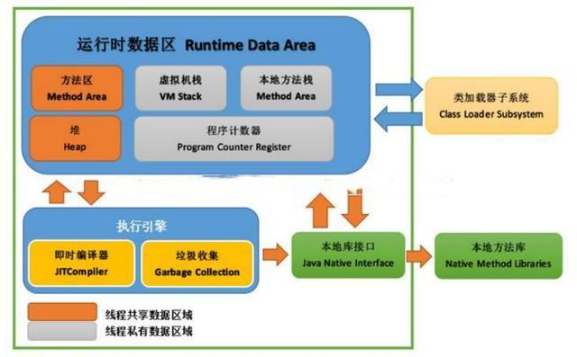
JVM
Notes:
Java虚拟机有自己完善的硬体架构，如处理器、堆栈、寄存器等，还具有相应的指令系统。
Java虚拟机屏蔽了与具体操作系统平台相关的信息，使得Java程序只需生成在Java虚拟机上运行的目标代码（字节码），就可以在多种平台上不加修改地运行。
简单来说JVM是用来解析和运行Java程序的。
java虚拟机定义了若干的程序运行期间会使用到的运行时数据区，其中会有一些随着虚拟机启动而启动，随着虚拟机的退出而销毁，比如线程独享的存储区域。
线程共享：堆，堆外内存(元空间)
线程独享： 计数器，本地方法栈，虚拟机栈。
https://blog.csdn.net/weixin_45984552/article/details/124053861

Slide 8
1.类加载器（Class Loader）：加载类文件到内存。
2.执行引擎（Execution Engine）：也叫解释器，负责解释命令，交由操作系统执行。
3.本地库接口（Native Interface）：本地接口的作用是融合不同的语言为java所用
4.运行时数据区（Runtime Data Area）:即JVM的内存

Slide 9
堆。堆是java对象的存储区域，任何用new字段分配的java对象实例和数组，都被分配在堆上
方法区：用于存储已被虚拟机加载的类信息，常量，静态变量，即时编译器编译后的代码等数据
虚拟机栈：虚拟机栈中执行每个方法的时候，都会创建一个栈桢用于存储局部变量表，操作数栈，动态链接，方法出口等信息。
本地方法栈：执行每个本地方法的时候，都会创建一个栈帧用于存储局部变量表，操作数栈，动态链接，方法出口等信息。
程序计数器。指示Java虚拟机下一条需要执行的字节码指令

Slide 10
Java goes on to wrap all the complex tasks that have become important, such as multithreading and network programming, in language features or libraries that can at times make those tasks trivial.
Java tackles some really big complexity problems: cross-platform programs, dynamic code changes, and even security.
So despite the performance problems we’ve seen, the promise of Java is tremendous: it can make us significantly more productive programmers.
Notes:
Java减少开发代码的时间和困难。
多线程和网络编程
跨平台编程 动态代码修改 安全问题
提高程序员的生产率
性能问题：不是直接和机器通讯。
https://markerhub.com/OnJava8/#/在线中文版

Slide 11
2、About Java Versions
1995 release Java
1996 java 1.0, 1.1,
Java 1.2 (J2SE,J2ME,J2EE) ,
2005 JDK5.0(Java SE ,Java EE, Java ME)version 5 brings several other amazing features to Java.
Java SE( Java Platform Standard Edition)标准版
Java EE( Java Platform Enterprise Edition)企业版
Java ME( Java Platform Micro Edition)小型版
Notes:
java从1995年发布到现在，也走过23年了，个人认为，其中几个java版本都肩负着重大使命，影响甚远；
jdk1.0 1995年5月23日诞生，Oak语言改名为Java，并提出“Write Once ，Run anywhere"；
jdk1.2 1999年6月发布，将java划分为J2SE,J2ME,J2EE三大平台；
jdk1.4 主要是性能提升，在2000年时候JAVA成为世界上最流行的电脑语言，
jdk5 诞生于2004年，他的使命就是易用，加入1. 泛型 2 自动装箱/拆箱 3 for-each 4 static import 5 变长参数等
Java 9 模块化系统 模块化的 JAR 文件都包含一个额外的模块描述器，描述jar包间的依赖关系。
Jshell:交互式解释器环境

Slide 12
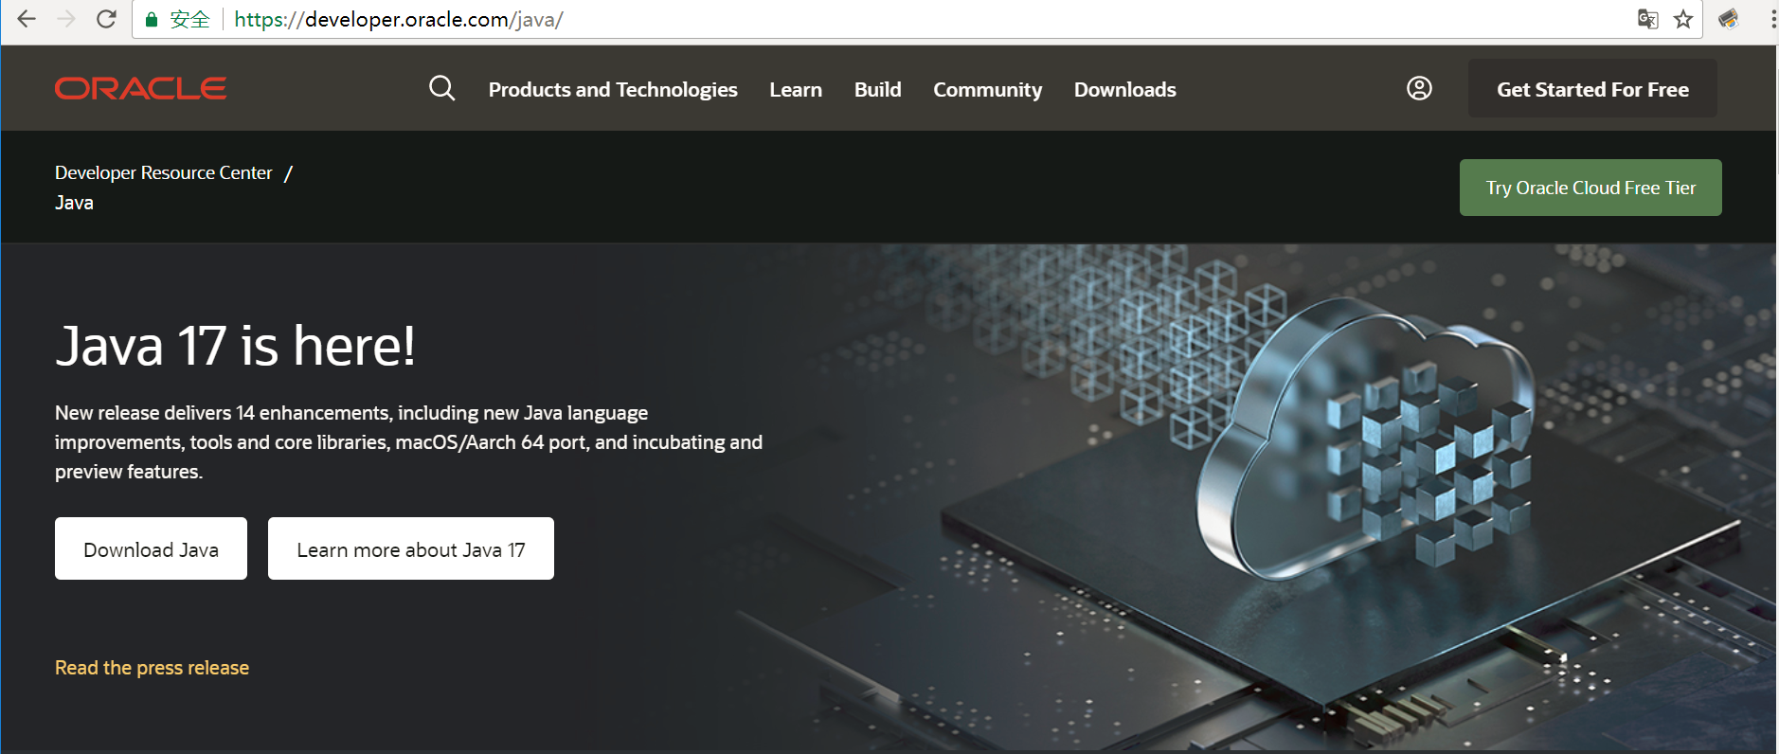
2、About Java Versions
Java 9 (JDK 9) brings JShell and Modulairty
Java 17
Notes:
java从1995年发布到现在，也走过18年了，个人认为，其中几个java版本都肩负着重大使命，影响甚远；
jdk1.0 1995年5月23日诞生，Oak语言改名为Java，并提出“Write Once ，Run anywhere"；
jdk1.2 1999年6月发布，将java划分为J2SE,J2ME,J2EE三大平台；
jdk1.4 主要是性能提升，在2000年时候JAVA成为世界上最流行的电脑语言，
jdk5 诞生于2004年，他的使命就是易用，加入1. 泛型 2 自动装箱/拆箱 3 for-each 4 static import 5 变长参数等
Java 9 模块化系统 模块化的 JAR 文件都包含一个额外的模块描述器，描述jar包间的依赖关系。
Jshell:交互式解释器环境
https://developer.oracle.com/java/

Slide 13
3、java运行环境的搭建
Online documentation
The Java language and libraries (a free download) come with documentation in electronic form, readable using a Web browser.
It’s usually much faster if you find the class descriptions with your Web browser than if you look them up in a book (and the on-line documentation is probably more up-to-date).

Slide 14
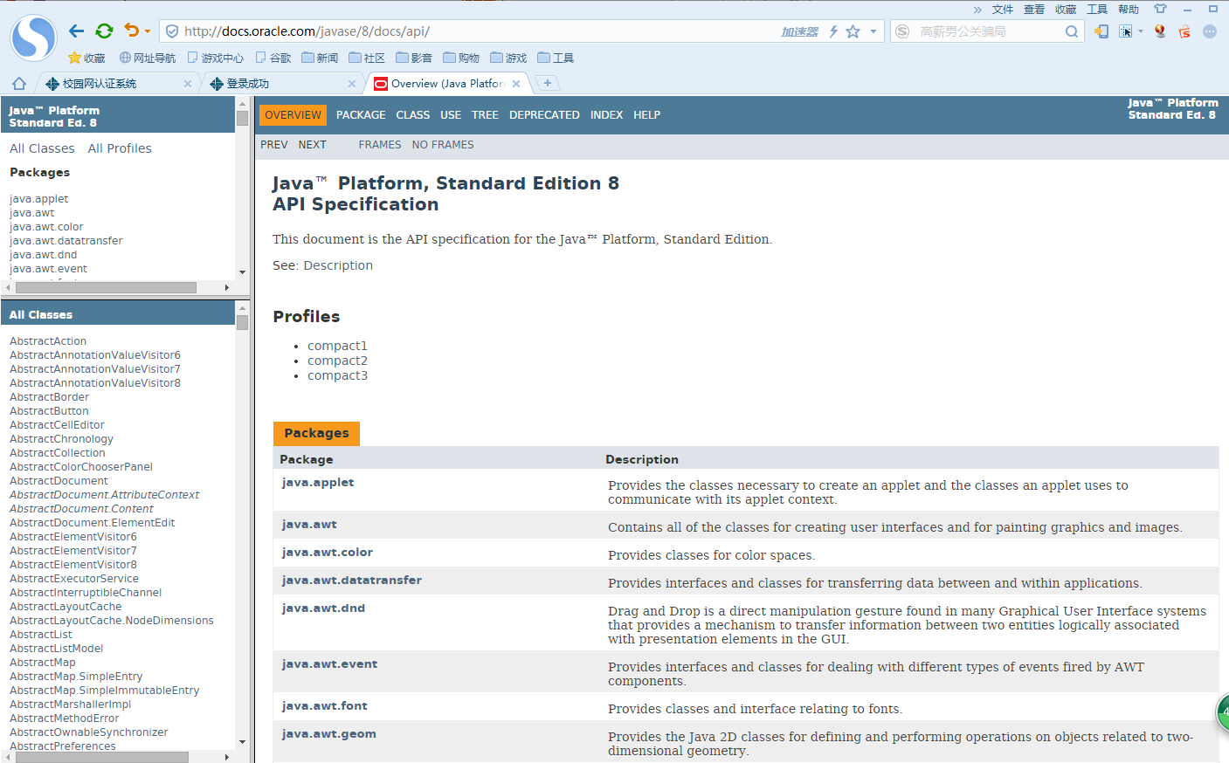
http://docs.oracle.com/javase/8/docs/api/
Notes:
http://docs.oracle.com/javase/8/docs/api/

Slide 15
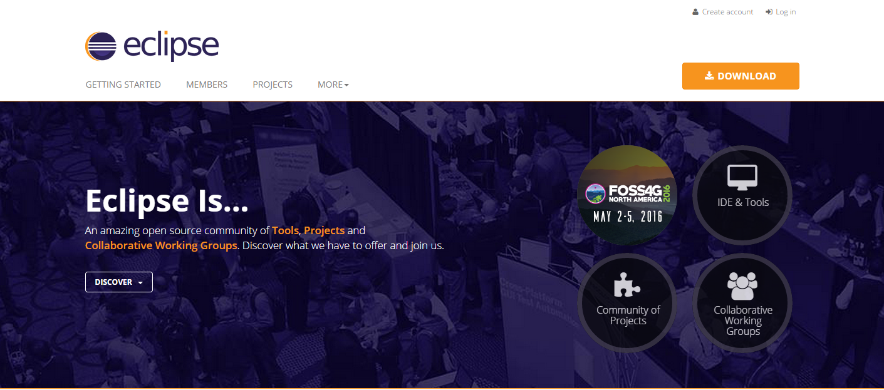
Java IDE：本课程演示使用eclipse
JDK的下载和安装：https://www.oracle.com/technetwork/java/javase/downloads/index.html
IDEA:https://www.jetbrains.com/zh-cn/idea/
Notes:
Java代码编辑器
1.)开源免费Java IDE Eclipse http://www.eclipse.org/ 最有名的Java IDE，插件资源非常丰富。 2.)开源免费Java IDE NetBeans http://www.netbeans.org/ 配置比Eclipse简单、汉化做得不错、装插件方便、在线中文文档多。 3.)收费Java IDE JBuilder http://www.embarcadero.com/products/jbuilder 插件丰富，体积大、资源占用大。 4.)收费Java IDE IntelliJ IDEA http://www.evget.com/product/2992 被公认为最好的Java开发平台之一，调试功能非常优秀。 5.)免费Java IDE JDeveloper (Oracle) http://www.oracle.com/technology/products/jdev 支持UML建模、调试功能优秀。 6.)收费Java IDE SlickEdit http://www.slickedit.com/ 易于安装和配置、支持的平台丰富、调试功能强大。 7.)开源Java IDE jEdit http://www.jedit.org/ 内嵌的Beanshell引擎、灵活、执行效率高。 8.)开源Java IDE JCreater http://www.jcreator.com/ 小而且快，常用的功能都支持，很适合初学者。

Slide 16
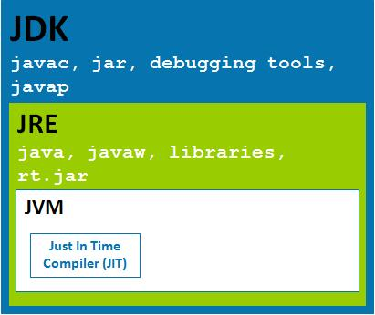
JDK JRE JVM：
JDK（Java Development Kid，Java 开发开源工具包）：包括了 Java 运行环境 JRE、Java 工具和 Java 基础类库。
JRE（Java Runtime Environment，Java 运行环境）：包含 JVM及 Java 核心类库。
JVM（Java Virtual Machine，Java 虚拟机）
Notes:
http://c.biancheng.net/java/

Slide 17
Chapter 1: Introduction to Objects
This chapter is an overview of what object-oriented programming is all about, including objects, interface vs. implementation, abstraction and encapsulation, messages and functions, inheritance and composition, and the all-important polymorphism.
We’ll learn what makes Java special, why it’s been so successful, and about object-oriented analysis and design.
Notes:
本章中介绍的重要概念后续章节中都会出现，以实例讲解。
对象导论：概述了面向对象程序设计的各项内容，包括“什么是对象？”这样的基本问题，以及接口与实现、抽象与封装、消息与函数、继承与组合、多态等等重要概念

Slide 18
Chapter 2: Everything is an Object
This chapter gives an overview of the essentials, including the concept of a reference to an object; how to create an object; an introduction to primitive types and arrays; scoping and the way objects are destroyed by the garbage collector; how everything in Java is a new data type (class) and how to create our own classes.
Chapter 3: Controlling Program Flow
This chapter begins with all of the operators that come to Java from C and C++. In addition, we’ll discover common operator pitfalls, casting, promotion, and precedence.
Notes:
第二章：一切都是对象(2个学时)
本章介绍对象的各项要点，
本章介绍对象的各项要点，包括对象引用的概念，如何创建对象，基本数据类型和数组的概念，对象作用域以及垃圾回收器的概念，如何创建类，如何编写Java程序
第三章：控制程序流程 (3学时)
本章讲述了Java中的运算符，它们大多来自C及C++语言。本章包括各运算符的用法，以及易犯的错误、类型转换、类型提升、优先级顺序等内容。接着本章讲述了各种程序流程的运用

Slide 19
This is followed by the basic control-flow. Note : Java’s labeled break and labeled continue (which account for the “missing goto” in Java).
Although much of this material has common threads with C and C++ code, there are some differences.
Chapter 4: Initialization & Cleanup
This chapter begins by introducing the constructor, which guarantees proper initialization.
This chapter also explores the garbage collector and some of its idiosyncrasies. And the chapter concludes with a closer look at how things are initialized.
Notes:
control-flow:控制流
初始化与清理操作 (3学时)
本章讲述了构造函数的用法，它用来确保正确的初始化。接着讨论了清理操作，包括垃圾回收器以及它的一些特性。本章总结了对象初始化的过程

Slide 20
Chapter 5: Hiding the Implementation
This chapter covers the way that code is packaged together, and why some parts of a library are exposed while other parts are hidden.
Keywords package and import perform file-level packaging and allow you to build libraries of classes.
Chapter 6: Reusing Classes
The concept of inheritance is standard in virtually all OOP languages.
Notes:
第五章：包与访问权限修饰符 (3学时)
本章包括了代码被组织成包的方式，以及为何类库的某一部分对外可见，而另一部分对外不可见。学会自己开发类库。
第六章：复用类 (2学时)
继承是一个经常使用的代码重用方式，它保持基类不变，在其基础上添加内容，产生所需的派生类。我们也可使用组合来重用代码，具体做法是把已有类的对象嵌入到新类中去。

Slide 21
Inheritance is often a way to reuse code by leaving the “base class” the same, and just patching things here and there to produce what you want.
However, inheritance isn’t the only way to make new classes from existing ones. You can also embed an object inside your new class with composition.
Chapter 7: Polymorphism
In this chapter we’ll see how to create a family of types with inheritance and manipulate objects in that family through their common base class. Java’s polymorphism allows us to treat all objects in this family generically.
Notes:
第7多态 (2学时)
Java中的多态允许我们以同样的方式来操作同属一个继承体系的对象（既操作具有通用性），这意味着该部分代码不依赖于特定的类型信息。多态使得程序具有良好的可扩展性，也使程序编写及代码维护更为方便

Slide 22
Chapter 8: Interfaces & Inner Classes
Java provides a third way to set up a reuse relationship --- the interface.
The interface is more than just an abstract class taken to the extreme. It allows us to perform a variation on C++’s multiple inheritance, by creating a class that can be upcast to more than one base type.
At first, inner classes look like a simple code hiding mechanism: we place classes inside other classes. However, the inner class does more than that—it knows about and can communicate with the surrounding class.
Notes:
接口和内部类 (3学时)
接口及内部类提供了组织和控制对象的更为复杂的方式。Interface关键字构建了一个纯抽象类，它不提供任何实现的代码。内部类了解其外部类的所有内容，并可以和它通信。以内部类形式编写的代码更为简洁和清晰。

Slide 23
Chapter 9: Holding our Objects
To solve the general programming problem, you need to create any number of objects, anytime, anywhere. This chapter explores in depth the container library that Java supplies to hold objects while you’re working with them.
Chapter 10: Error Handling with Exceptions
The basic philosophy of Java is that badly-formed code will not be run.
Java has exception handling to deal with any problems that arise while the program is running.
This chapter examines when we should throw exceptions and what to do when we catch them.
Notes:
对比C中的数组：定长。realloc, free。
第九章：持有对象 在java中容器是管理对象的生命周期，本章主要介绍容器类的使用。
第十章：通过异常处理错误。
exception handling 异常处理
Java通过异常处理实现“不让编写错误的代码运行”
什么时候抛出异常，抓住异常时做什么。

Slide 24
Chapter 11: The Java I/O System
Theoretically, you can divide any program into three parts: input, process, and output.
In this chapter we’ll learn about the different classes that Java provides for reading and writing files, blocks of memory, and the console.
Java’s object serialization
Chapter 12: Run-Time Type Identification
Java run-time type identification (RTTI) lets us find the exact type of an object when we have a reference to only the base type.
Notes:
11本章将介绍Java用于I/O的各种类，包括读写文件、内存块、控制台等等，同时将比较新旧I/O库的异同
12 运行时的类型识别（反射机制）

Slide 25
This chapter explains what RTTI is for, how to use it, and how to get rid of it when it doesn’t belong there.
Chapter 13: Creating Windows and Applets
Java comes with the “Swing” GUI library, which is a set of classes that handle windowing in a portable fashion.
These windowed programs can either be applets or stand-alone applications.
“JavaBeans” technology
Notes:
演示用IDEA建立图形界面程序。

Slide 26
Chapter 14: Multiple Threads
Java provides a built-in facility to support multiple concurrent subtasks, called threads, running within a single program.
Threads are most apparent when trying to create a responsive user interface.
Chapter 15: Building Java EE Applications
Servlets and JSPs, JDBC, Tomcat, Struts, Spring, Hibernate
Notes:
线程：多重并发的子任务。

Slide 27
Chapter 1: Introduction to Objects
This chapter will introduce us to the basic concepts of OOP, including an overview of development methods.
1.1 The progress of abstraction
All programming languages provide abstractions. It can be argued that the complexity of the problems we’re able to solve is directly related to the kind and quality of abstraction.
the machine model
(in the “solution space” )
the model of the problem
(in the “problem space”)

Slide 28
The alternative to modeling the machine is to model the problem we’re trying to solve. Each of these approaches is a good solution to the particular class of problem, but when we step outside of that domain they become awkward.
The object-oriented approach goes a step further by providing tools for the programmer to represent elements in the problem space.
The idea is that the program is allowed to adapt itself to the lingo of the problem by adding new types of objects, so when you read the code describing the solution, you’re reading words expressing the problem. OOP allows us to describe the problem in terms of the problem.

Slide 29
The following characteristics represent a pure approach to object-oriented programming:
1. Everything is an object.
2. A program is a bunch of objects telling each other what to do by sending messages.
3. Each object has its own memory made up of other objects.
4. Every object has a type.
5. All objects of a particular type can receive the same messages.

Slide 30
1.2 An object has an interface
Creating abstract data types (classes) is a fundamental concept in object-oriented programming.
Each object belongs to a particular class that defines its characteristics and behaviors.
type
class
Once a class is established, you can make as many objects of that class as you like.

Slide 31
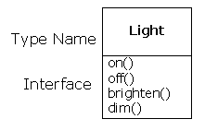
The interface establishes what requests you can make for a particular object. A type has a function associated with each possible request, and when you make a particular request to an object, that function is called.
1.3 The hidden implementation
It is helpful to break up the playing field into class creators and client programmers(the class consumers).

Slide 32
The hidden portion usually represents the tender insides of an object. So hiding the implementation reduces program bugs.
The first reason for access control is to keep client programmers’ hands off portions they shouldn’t touch. The second reason is to allow the library designer to change the internal workings of the class without worrying about how it will affect the client programmer.
In Java: public , private , protected
Java also has a “default” access --- “friendly” access
Classes can access the friendly members of other classes in the same package, but outside of the package those same friendly members appear to be private.

Slide 33
1.4 Reusing the implementation
Code reuse is one of the greatest advantages that object-oriented programming languages provide.
The simplest way to reuse a class is to just use an object of that class directly, but you can also place an object of that class inside a new class.
Inheritance is often highly emphasized. We should first look to composition when creating new classes, since it is simpler and more flexible.

Slide 34
1.5 Inheritance: reusing the interface
A base type contains all of the characteristics and behaviors that are shared among the types derived from it. From the base type, you derive other types to express the different ways that the core ideas can be realized.
The derived type contains not only all the members of the existing type, but more important, it duplicates the interface of the base class. All the messages you can send to objects of the base class can also be sent to objects of the derived class.

Slide 35
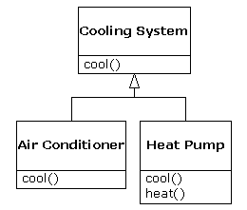
We have two ways to differentiate the derived class from the original base class. 1. Add brand new functions to the derived class. 2. (more important) Change the behavior of an existing base-class function. ---- Overriding
Pure substitution
is - a
is – like - a

Slide 36
1.6 Interchangeable objects
with polymorphism
When dealing with type hierarchies, we often want to treat an object not as the specific type, but instead as its base type. This allows us to write code that doesn’t depend on specific types.
The function call generated by a non-OOP compiler causes early binding.
Compiler
linker
specific function name
absolute code address

Slide 37
Object-oriented languages use the concept of late binding. When we send a message to an object, the code being called isn’t determined until run-time.
To perform late binding, Java uses a special bit of code instead of the absolute call. In Java dynamic binding is the default. ---- no virtual
Using polymorphism, the code we write is decoupled from type-specific information, and is simpler to write and easier to understand. Thus, the program is extensible.

Slide 38
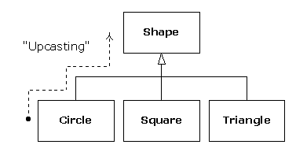
We call the process of treating a derived type as though it were its base type upcasting.
You don’t want to create an object of the base class, only to upcast to it so that its interface can be used.
---- abstract class

Slide 39
An abstract method may be created only inside an abstract class. When the class is inherited, that method must be implemented, or the inheriting class becomes abstract as well.
The interface keyword prevent any function definitions at all. ---- one step further
It provides the perfect separation of interface and implementation.

Slide 40
1.7 Object landscapes and lifetimes
1.The way objects are created and destroyed.
C++: For efficiency, it gives the programmer a choice.
Placing the objects on the stack or in the static storage area can get the maximum run-time speed. However, you sacrifice flexibility .
We can also create objects dynamically in the heap. You can simply make an object on the heap when you need it. ---- The greater flexibility
The general assumption : Objects tend to be complicated, so the extra overhead of finding and releasing the storage will not affect the creation of an object heavily.

Slide 41
Java uses the second approach, exclusively. ---- use the new keyword to build a dynamic instance of an object.
2.The lifetime of an object.
In C++, you must determine programmatically when to destroy the object, which can lead to memory leaks if you don’t do it correctly.
Java provides a garbage collector that automatically discovers when an object is no longer in use and destroys it.
(1) Collections and iterators
We create another type of object. The new type of object holds references to other objects. ---- Container (or collection)
It will expand itself whenever necessary to accommodate everything you place inside it.

Slide 42
Java also has containers in its standard library.
The container, via the iterator, is abstracted to be simply a sequence. The iterator allows you to traverse that sequence without worrying about the underlying structure—an ArrayList, a LinkedList, a Stack, or something else.
To choose a container: 1. Containers provide different types of interfaces and external behavior. 2. Different containers have different efficiencies for certain operations.

Slide 43
(2) The singly rooted hierarchy
All objects in a singly rooted hierarchy have an interface in common, so they are all ultimately the same type.
All objects in a singly rooted hierarchy can be guaranteed to have certain functionality.
A singly rooted hierarchy makes it much easier to implement a garbage collector (which is conveniently built into Java).

Slide 44
(3) Downcasting vs. templates/generics
It’s not completely dangerous because if you downcast to the wrong thing you’ll get an exception.
The solution is parameterized types, which are classes that the compiler can automatically customize to work with particular types.
Parameterized types are an important part of C++, partly because C++ has no singly rooted hierarchy. Java currently has no parameterized types.
ArrayList <Shape> shapes = new ArrayList <Shape>();

Slide 45
(4) Garbage collectors vs. efficiency and flexibility
The garbage collector is a particular problem because you never quite know when it’s going to start up or how long it will take. This means that there’s an inconsistency in the rate of execution of a Java program, so you can’t use it in real time programs.
Java is simpler than C++, but the trade-off is in efficiency and sometimes applicability. For a significant portion of programming problems, however, Java is the superior choice.

Slide 46
1.8 Exception handling: dealing with errors
An exception is an object that is “thrown” from the site of the error and can be “caught” by an appropriate exception handler. It’s as if exception handling is a different, parallel path of execution that can be taken when things go wrong.
In Java, exception handling was wired in from the beginning and you’re forced to use it.
Note : Exception handling isn’t an object-oriented feature.

Slide 47
1.9 Multithreading
Java’s threading is built into the language. The threading is supported on an object level.
It can lock the memory of any object. --- synchronized
Other types of resources must be locked explicitly by the programmer.
1.10 Persistence
Java provides support for lightweight persistence.

Slide 48
1.11 Java and the Internet
(1) Client/Server computing
A key to the client/server concept is that the repository of information is centrally located so that it can be changed and those changes will propagate out to the information consumers.
The information repository, the software that distributes the information, and the machine(s) where the information and software reside is called the server.
The software that resides on the remote machine and communicates with the server is called the client.

Slide 49
Disadvantages:
1. As client software changes, it must be built, debugged, and installed on each client machine.
2. It’s especially problematic to support multiple types of computers and operating systems.
3. The all-important performance issue.
The entire client/server problem needs to be solved in a big way.

Slide 50
(2) Client-side programming
The Web’s initial server-browser design provided for interactive content, but the interactivity was completely provided by the server.
However, Web sites built on CGI programs can rapidly become overly complicated to maintain, and there is also the problem of response time.
The solution is client-side programming. The Web browser is harnessed to do whatever work it can.
1. Plug-ins
This is a way for a programmer to add new functionality to the browser by downloading a piece of code .

Slide 51
You need to download the plug-in only once.
The value of the plug-in is that it allows an expert programmer to develop a new language and add that language to a browser without the permission of the browser manufacturer. ---- Backdoor
2. Scripting languages
With a scripting language you embed source code for the client-side program directly into the HTML page.
The trade-off is that your code is exposed to everyone. And the scripting languages are really intended to solve specific types of problems.
JavaScript VBScript

Slide 52
3. Java
Java allows client-side programming via the applet.
An applet is a mini-program that will run only under a Web browser. The applet is downloaded automatically as part of a Web page. The programmer needs to create only a single program, and that program automatically works with all computers.
One advantage a Java applet has over a scripted program is that it’s in compiled form.
But A scripted program will just be integrated into the Web page as part of its text. This could be important to the responsiveness of your Web site.

Slide 53
4. .NET and C#
For a while, the main competitor to Java applets was Microsoft’s ActiveX, although it required that the client be running Windows.
Since then, Microsoft has produced a full competitor to Java in the form of the .NET platform and the C# programming language.
The .NET platform is roughly the same as the Java virtual machine and Java libraries, and C# bears unmistakable similarities to Java.
They had the considerable advantage of being able to see what worked well and what didn’t work so well in Java, and build upon that.

Slide 54
5. Internet vs. Intranet
The Web is the most general solution to the client/server problem.
When Web technology is used for an information network restricted to a particular company, it is referred to as an intranet.
If you are involved in such an intranet, the most sensible approach to take is the shortest path that allows you to use your existing code base.
(3) Server-side programming
A complicated request to a server generally involves a database transaction. These database requests must be processed via some code on the server side .
Servlets and JSP

Slide 55
1.12 Analysis and design
Evolution is the point in the development cycle that has traditionally been called “maintenance”. OOP languages are particularly adept at supporting this kind of continuing modification—the boundaries created by the objects tend to keep the structure from breaking down.
1.13 UML ( Rational Rose)
1. Use-Case Diagram
2. Static Diagram

Slide 56
3. Behavior Diagram
4. Interactive Diagram
5. Implementation Diagram
1.14 Extreme programming
(1) Write tests first
First, it forces a clear definition of the interface of a class.
Secondly, your tests become an extension of the safety net provided by the language.

Slide 57
(2) Pair programming
The value of pair programming is that one person is actually doing the coding while the other is thinking about it. If the coder gets stuck, they can swap places.
1.15 Why Java succeeds
Java is designed to be practical; Java language design decisions were based on providing the maximum benefits to the programmer.
1. Systems are easier to express and understand
2. Maximal leverage with libraries
3. Error handling
4. Programming in the large

Slide 58
1.16 Java vs. C++
The simplicity of Java over C++ will significantly shorten your development time.
Cross-compiling a program in Java should be a lot easier than doing so in C or C++.
A procedural program is data definitions and function calls. To find the meaning of such a program you have to look through the function calls and low-level concepts to create a model.
A well-written Java program is generally far simpler and much easier to understand than the equivalent C program.

Slide 59
Reference Books
Thinking in Java (Fourth Edition)，(美) Bruce Eckel，机械工业出版社，2007.6
Java 核心技术 (Core Java ) （原书第9版） 卷1：基础知识；卷2：高级特性， Horstmann & Cornell，机械工业出版社，2014.2
Java语言程序设计.基础篇（原书第10版），(美)Y.Daniel Liang(著)，机械工业出版社，2015.7
Java语言程序设计（第2版），沈泽刚 等，清华大学出版社，2014.1
Tomcat与Java Web开发技术详解（第2版），孙卫琴 ，电子工业出版社，2009.1

